Slide 1

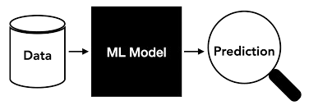
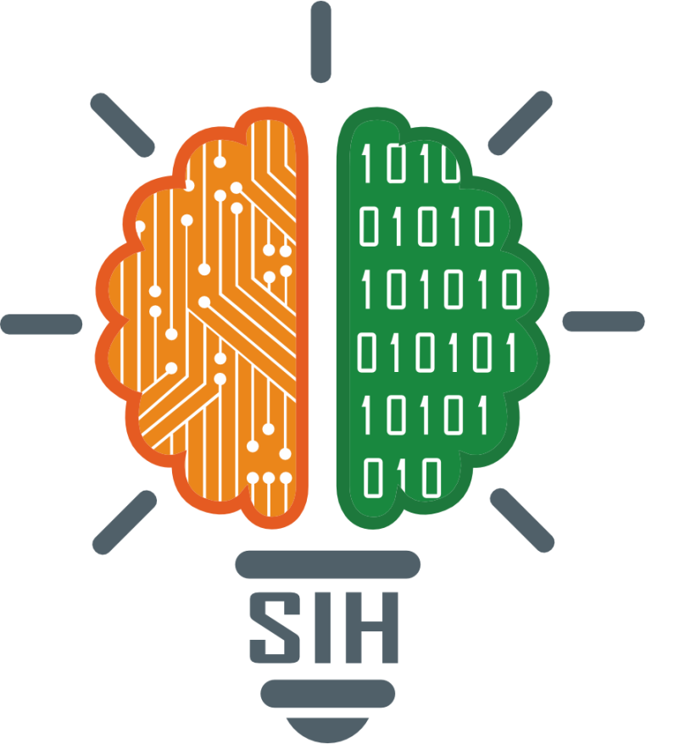



SMART INDIA HACKATHON 2024
Problem Statement ID –1624
Problem Statement Title- To develop an Artificial Intelligence (AI) based model for electricity demand projection including peak demand projection for Delhi Power system.
Theme- Smart Automation
PS Category - Software
Team ID - SIH125
Team Name – Team 404

Slide 2
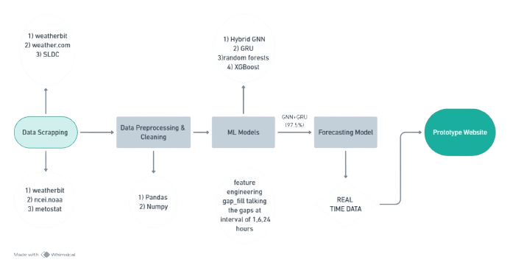
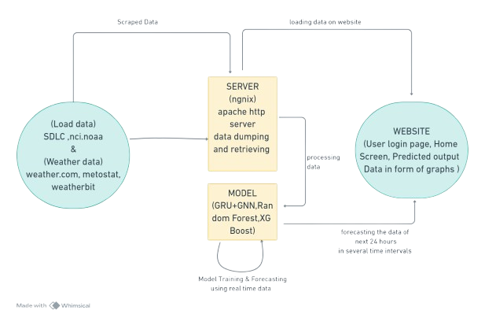
Artificial Intelligence (AI) based model for electricity demand projection
Team 404
Proposed Solution

Slide 3
TECHNICAL APPROACH
Team 404

Slide 4
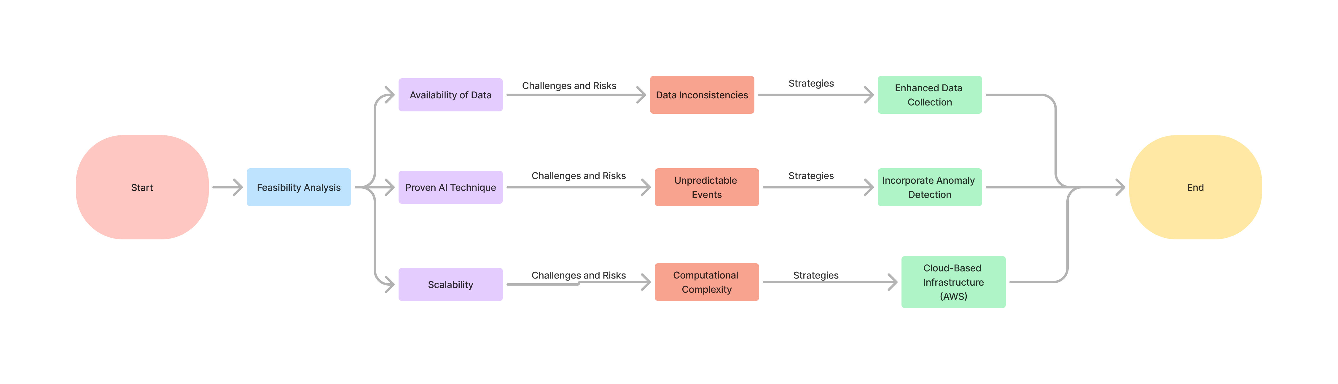
FEASIBILITY AND VIABILITY
Team 404

Slide 5
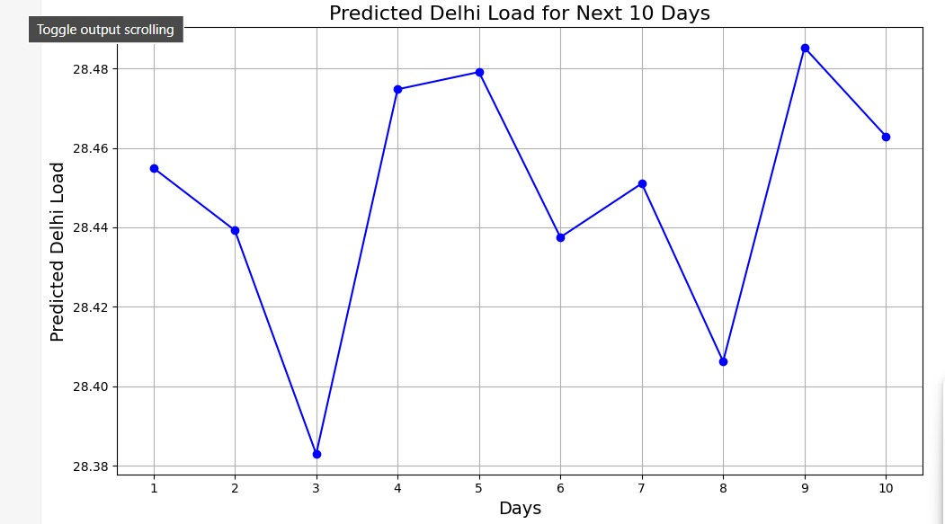
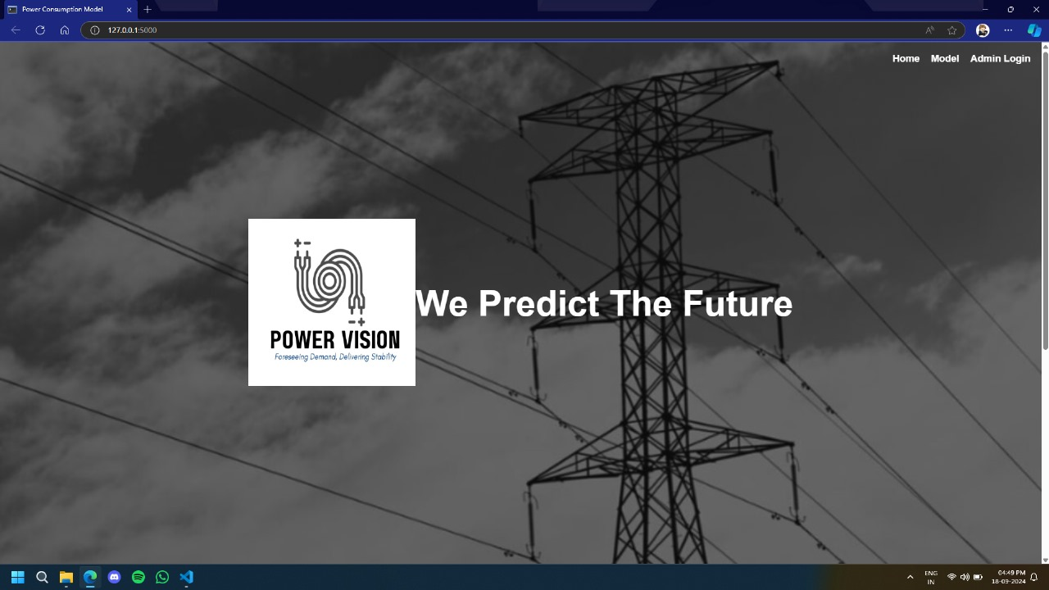
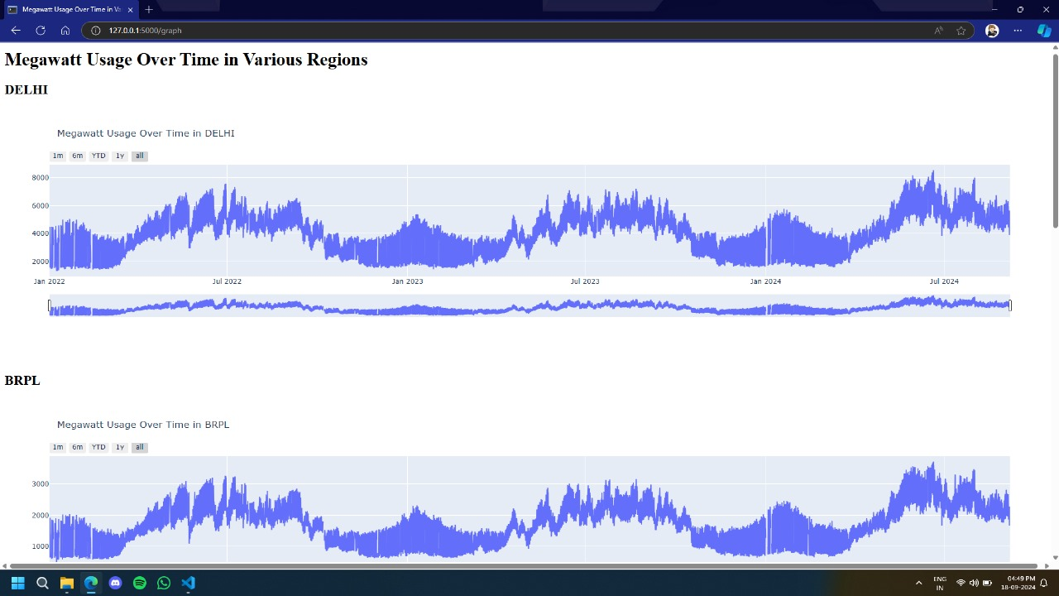
IMPACT AND BENEFITS
Team 404
Potential Impact
Social Benefits
Economic Benefits
More accurate power demand predictions aid in informed decision-making, reducing energy wastage and shortages
Improved reliability of electricity supply and enhanced quality of life with consistent energy access for Delhi residents
Reduced costs for utility and Decrease in energy wastage, leading to lower overall electricity costs for consumers.

Slide 6
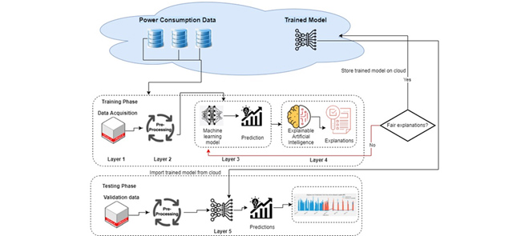
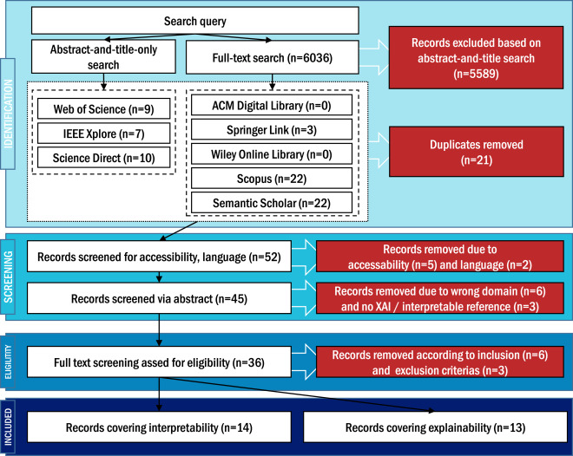
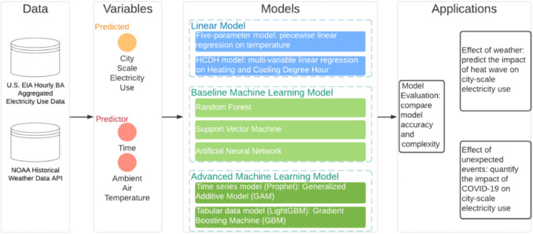
RESEARCH AND REFERENCES
Team 404
Munir, S., Pradhan, M. R., Abbas, S., & Khan, M. A. (2024). Energy Consumption Prediction Based on LightGBM empowered with eXplainable Artificial Intelligence. IEEE Access.(LINK)
Wang, Z., Hong, T., Li, H., & Piette, M. A. (2021). Predicting city-scale daily electricity consumption using data-driven models. Advances in Applied Energy, 2, 100025.(LINK)
Baur, L., Ditschuneit, K., Schambach, M., Kaymakci, C., Wollmann, T., & Sauer, A. (2024). Explainability and interpretability in electric load forecasting using machine learning techniques–A review. Energy and AI, 100358.(LINK)

